Slide 1


Team1
Final Presentation
Spring 2021
Vihan Parmar
Mady Dembele
Roneil Boodram
Lang Gong
George Lopez
Jevon Cowell
Tianqi Han
Maisha Masnoon

Slide 2
BRM
Context Diagram
Architecture Diagrams
RCT
Use Case Diagrams
Activity Diagrams
Data Flow Diagrams
ER Diagrams
User Stories
Test Plan
GitHub
App Demo

Slide 3
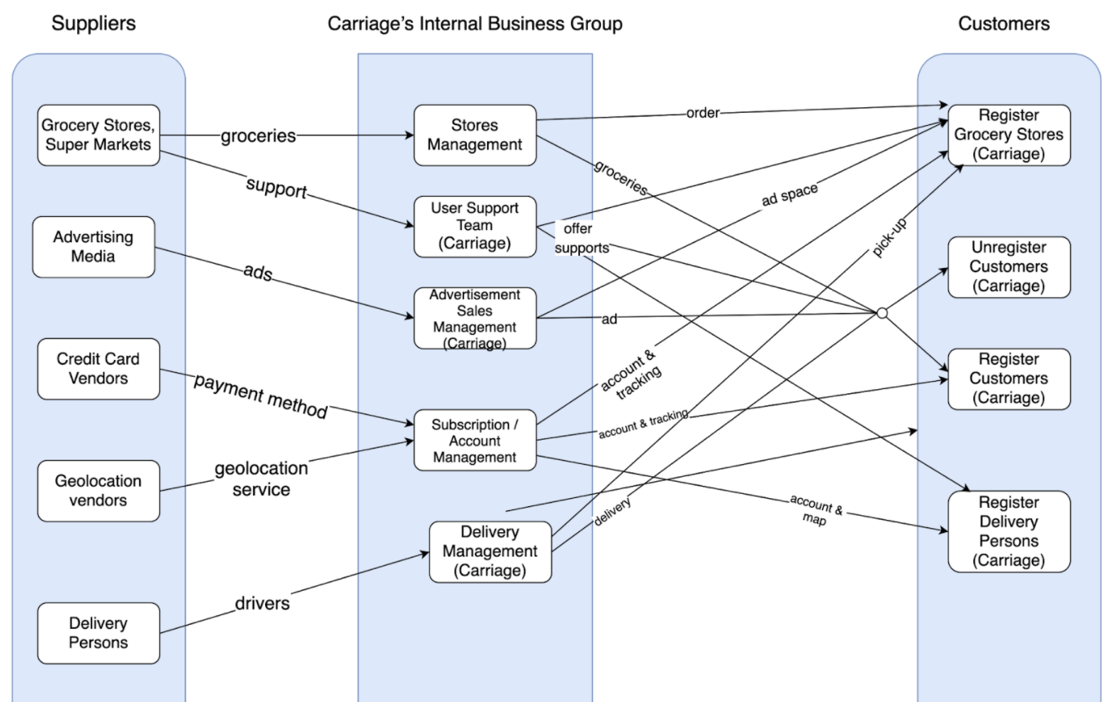
BRM
Presented by
Mady Dembele

Slide 4
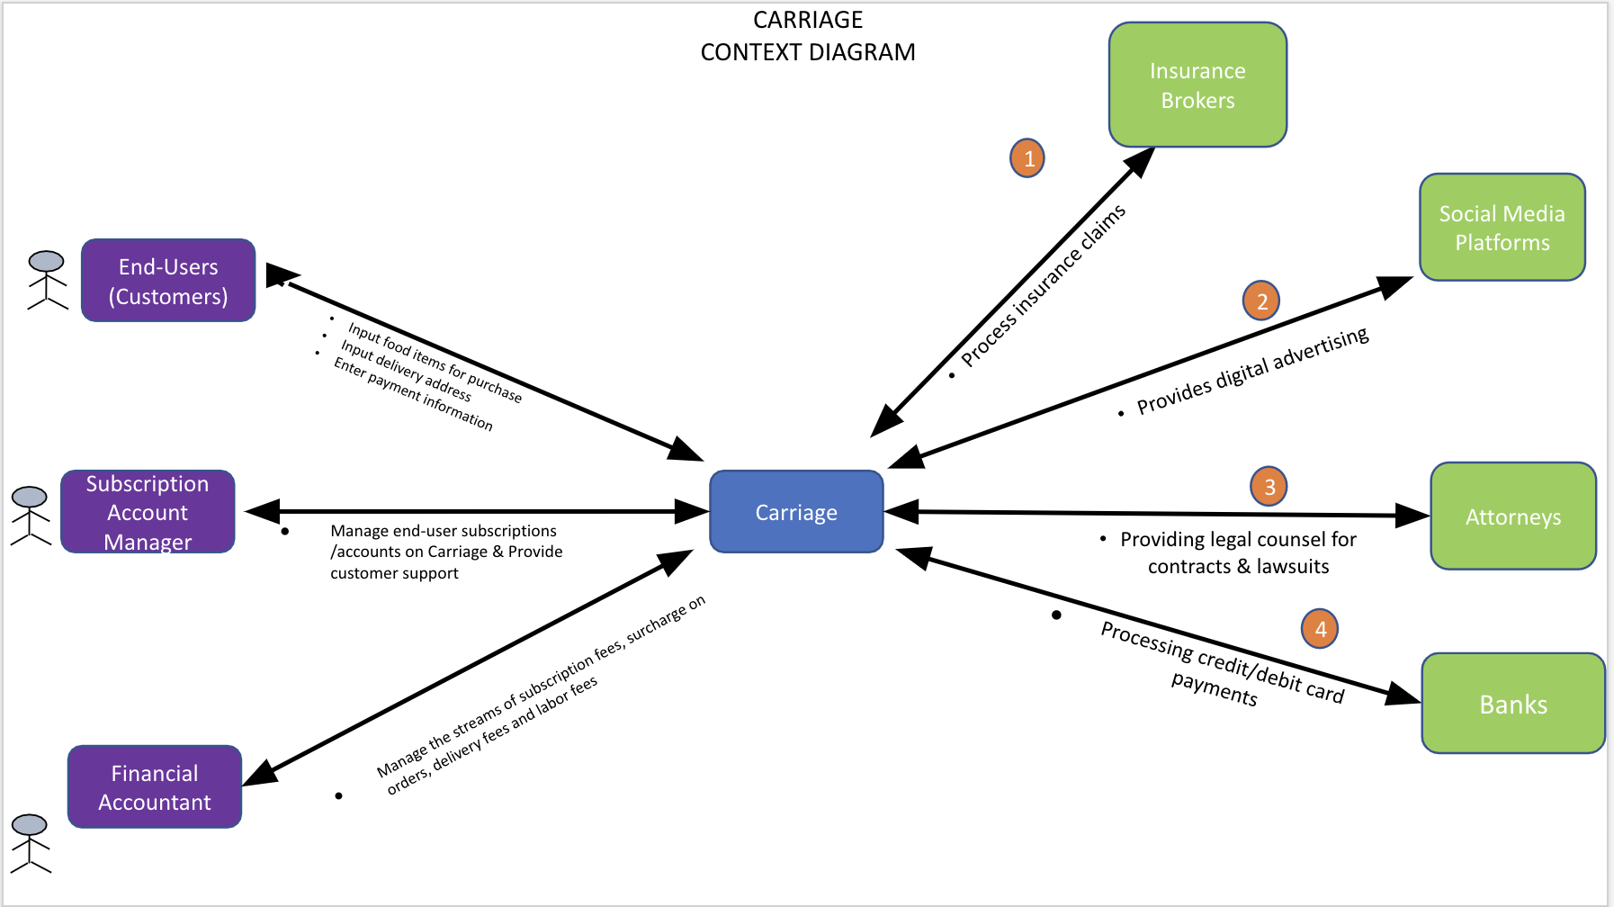
Context Diagram
Presented by
Roneil Boodram

Slide 5
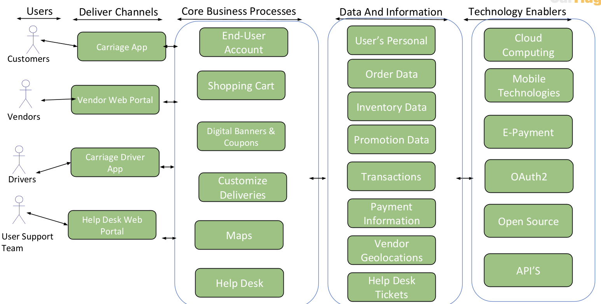
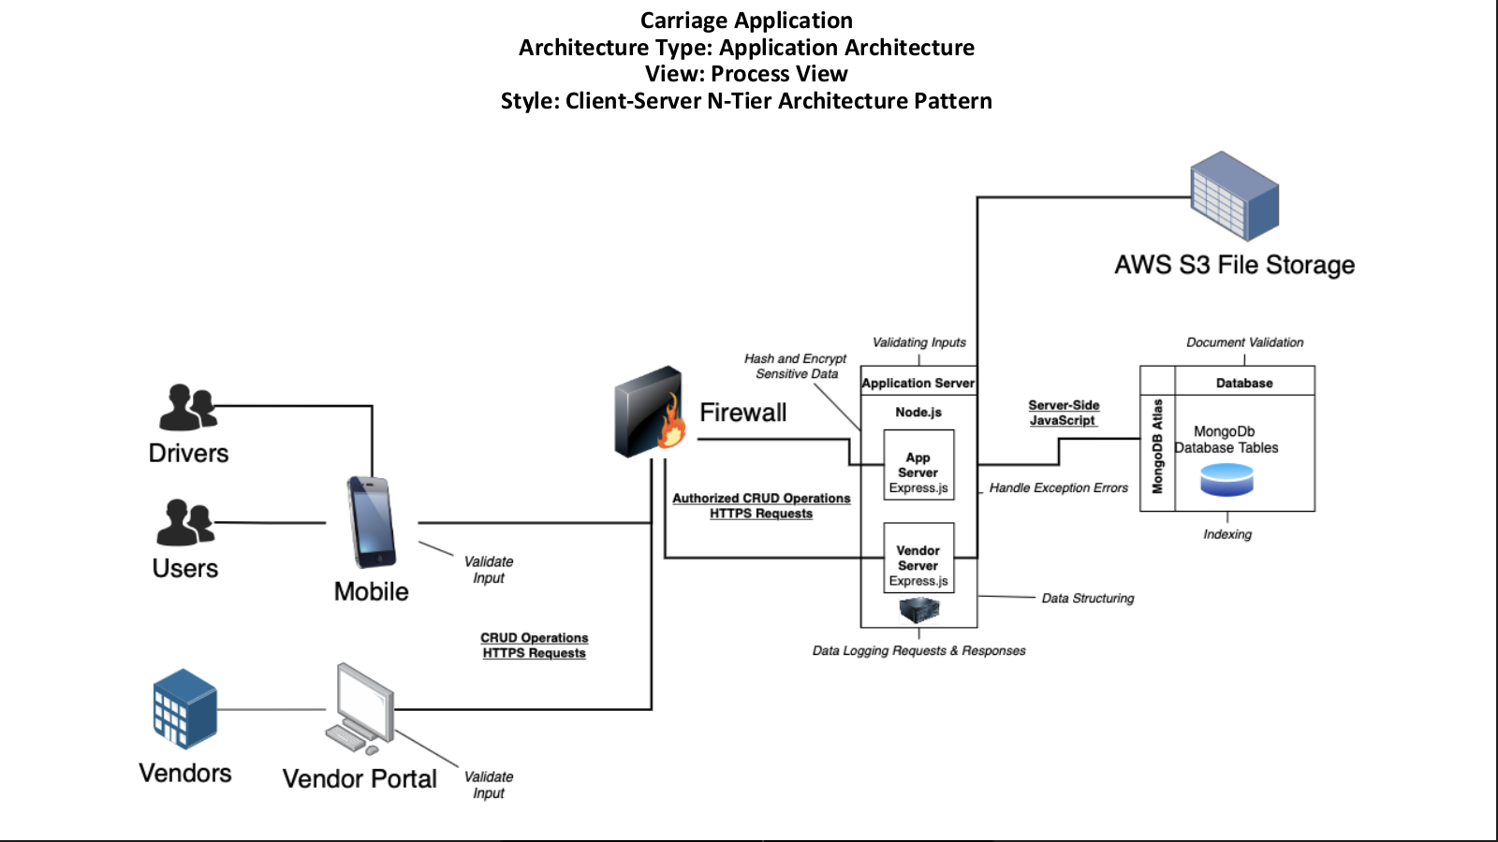
Architecture Diagrams
Presented by
George Lopez & Jevon Cowell

Slide 6
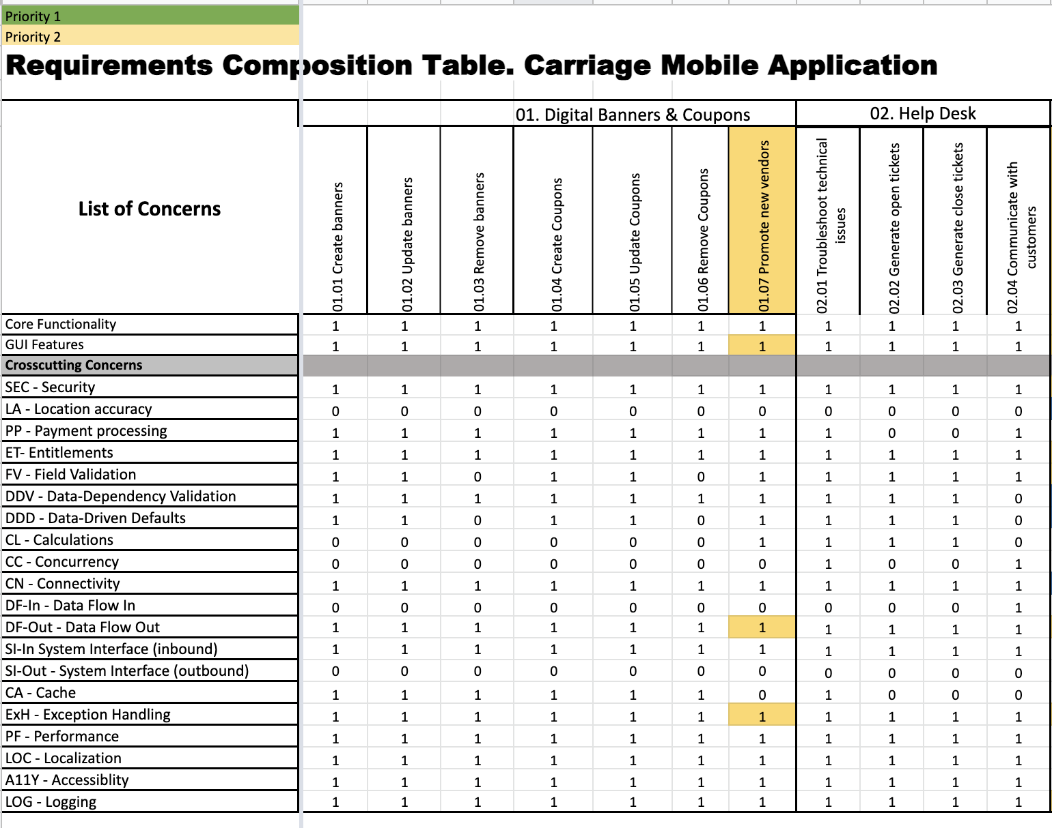
RCT
Presented by
Roneil Boodram

Slide 7
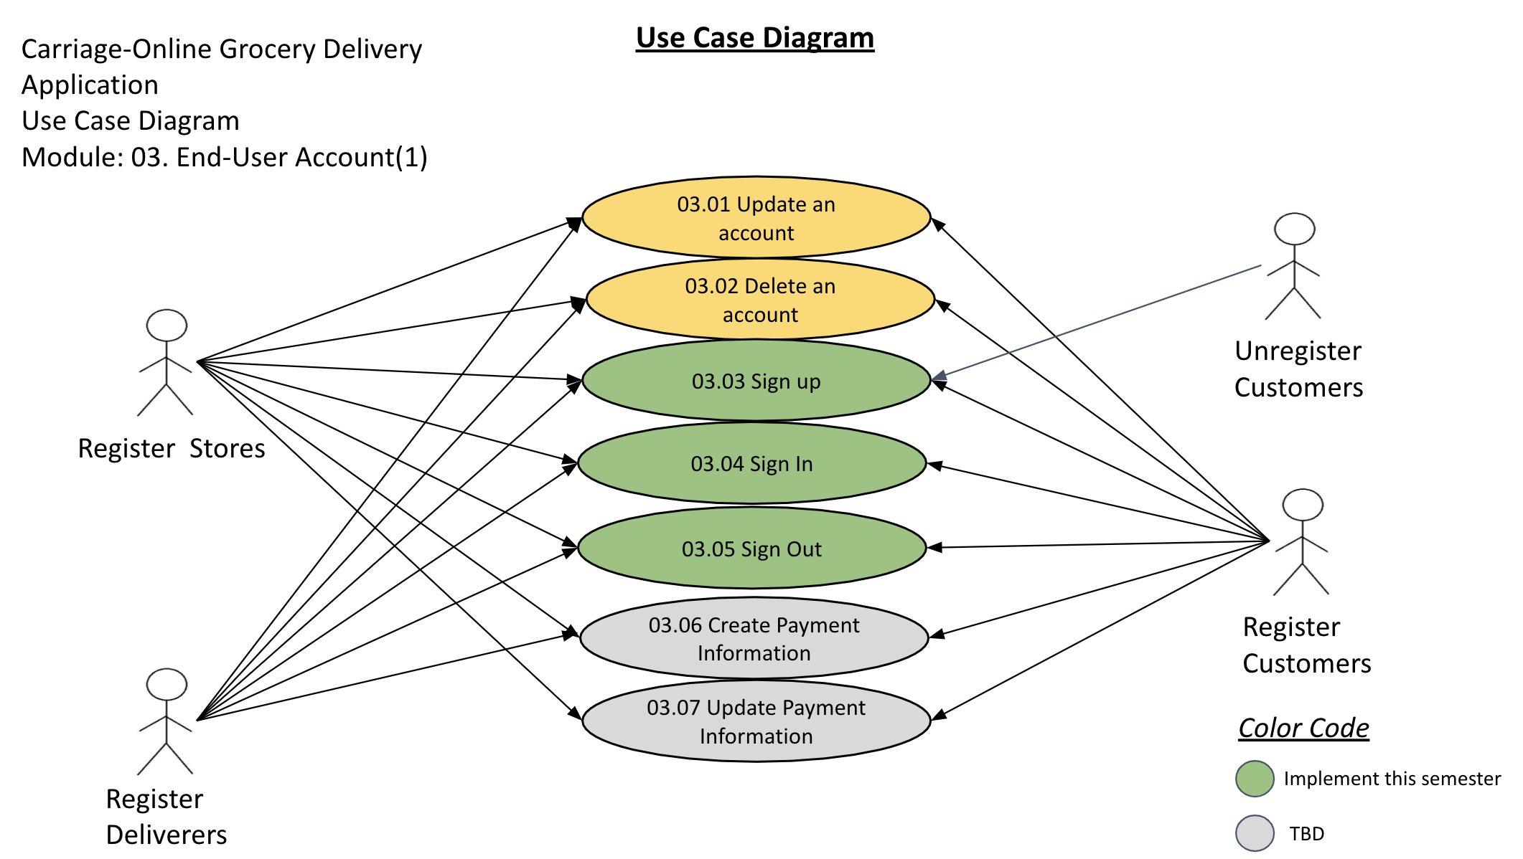
Use Case Diagrams
Presented by
Lang Gong

Slide 8
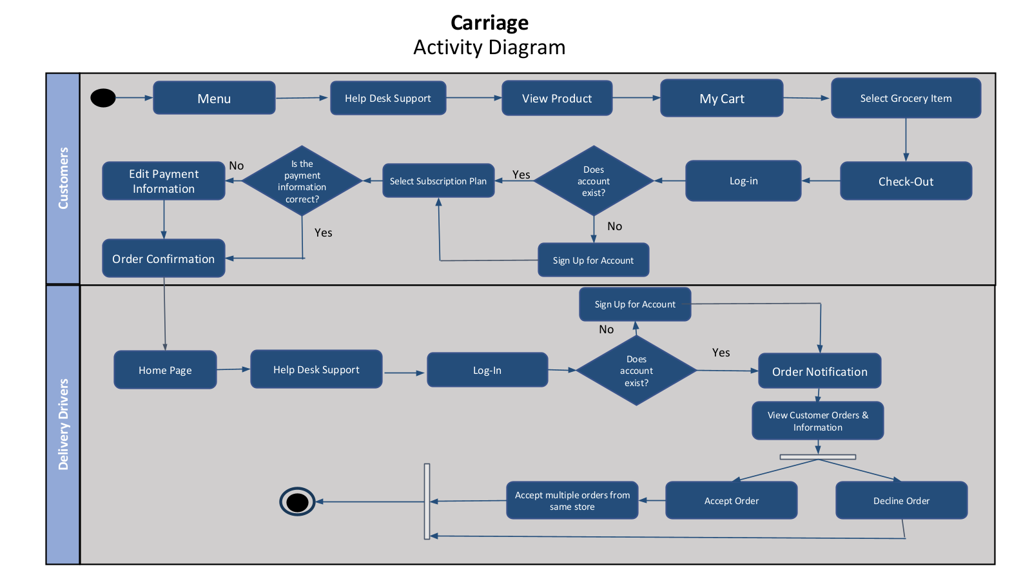
Activity Diagrams
Presented by
Vihan Parmar

Slide 9
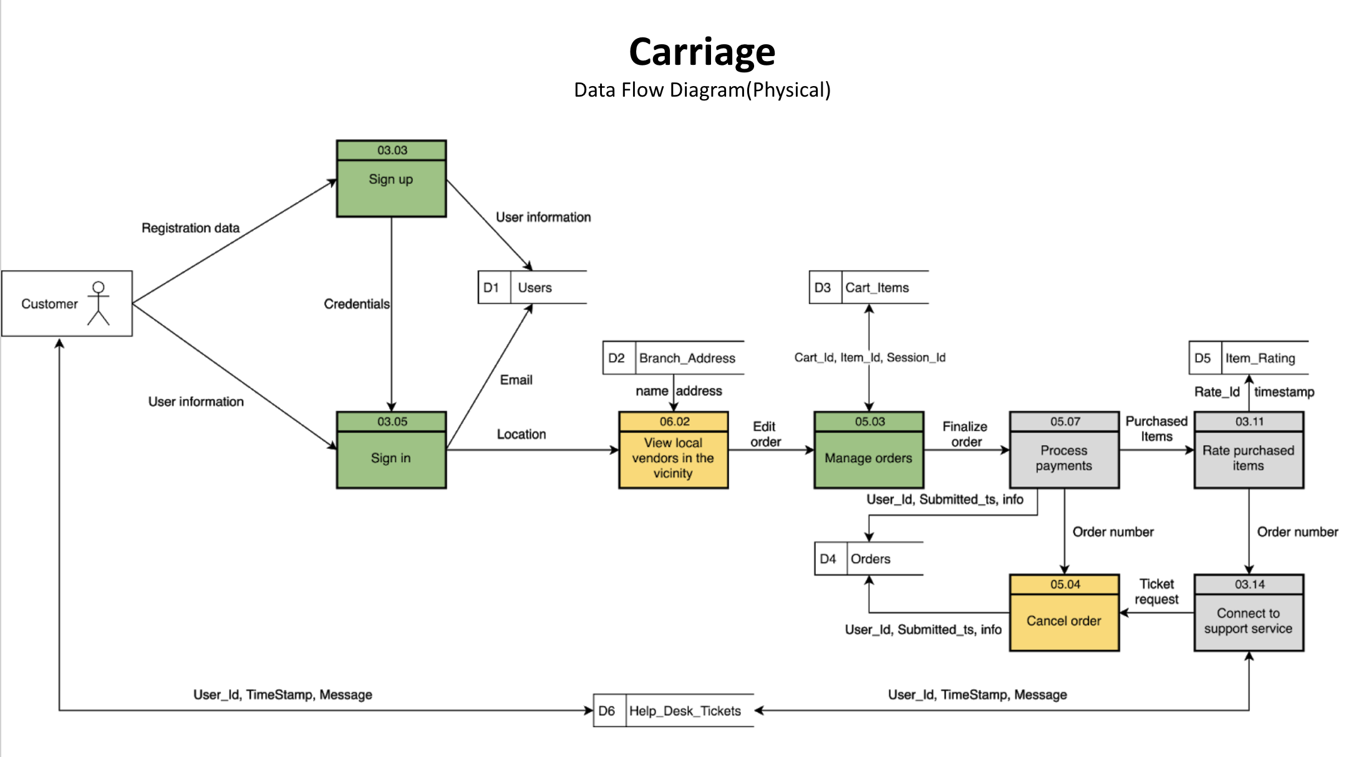
Data Flow Diagrams
Presented by
Jevon Cowell

Slide 10
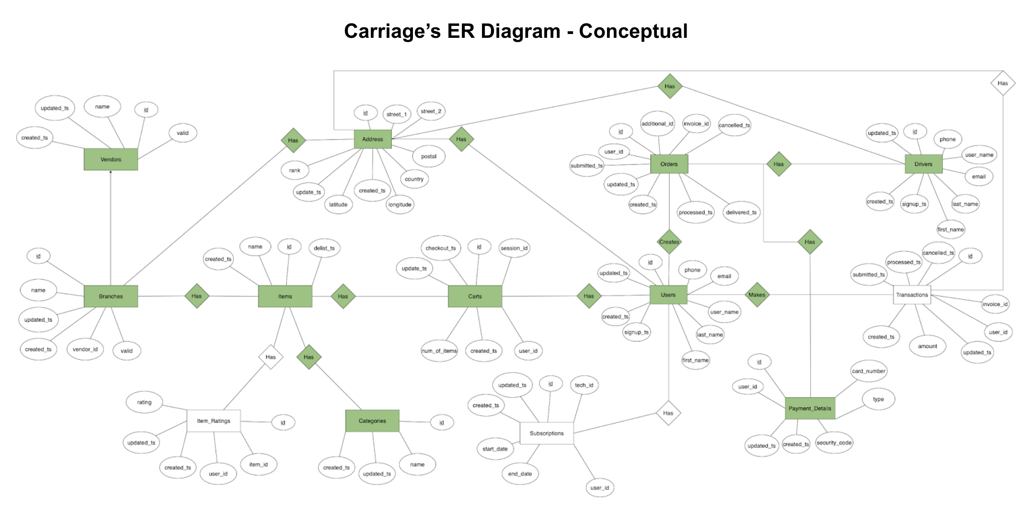
ER Diagrams
Presented by
George Lopez & Jevon Cowell

Slide 11
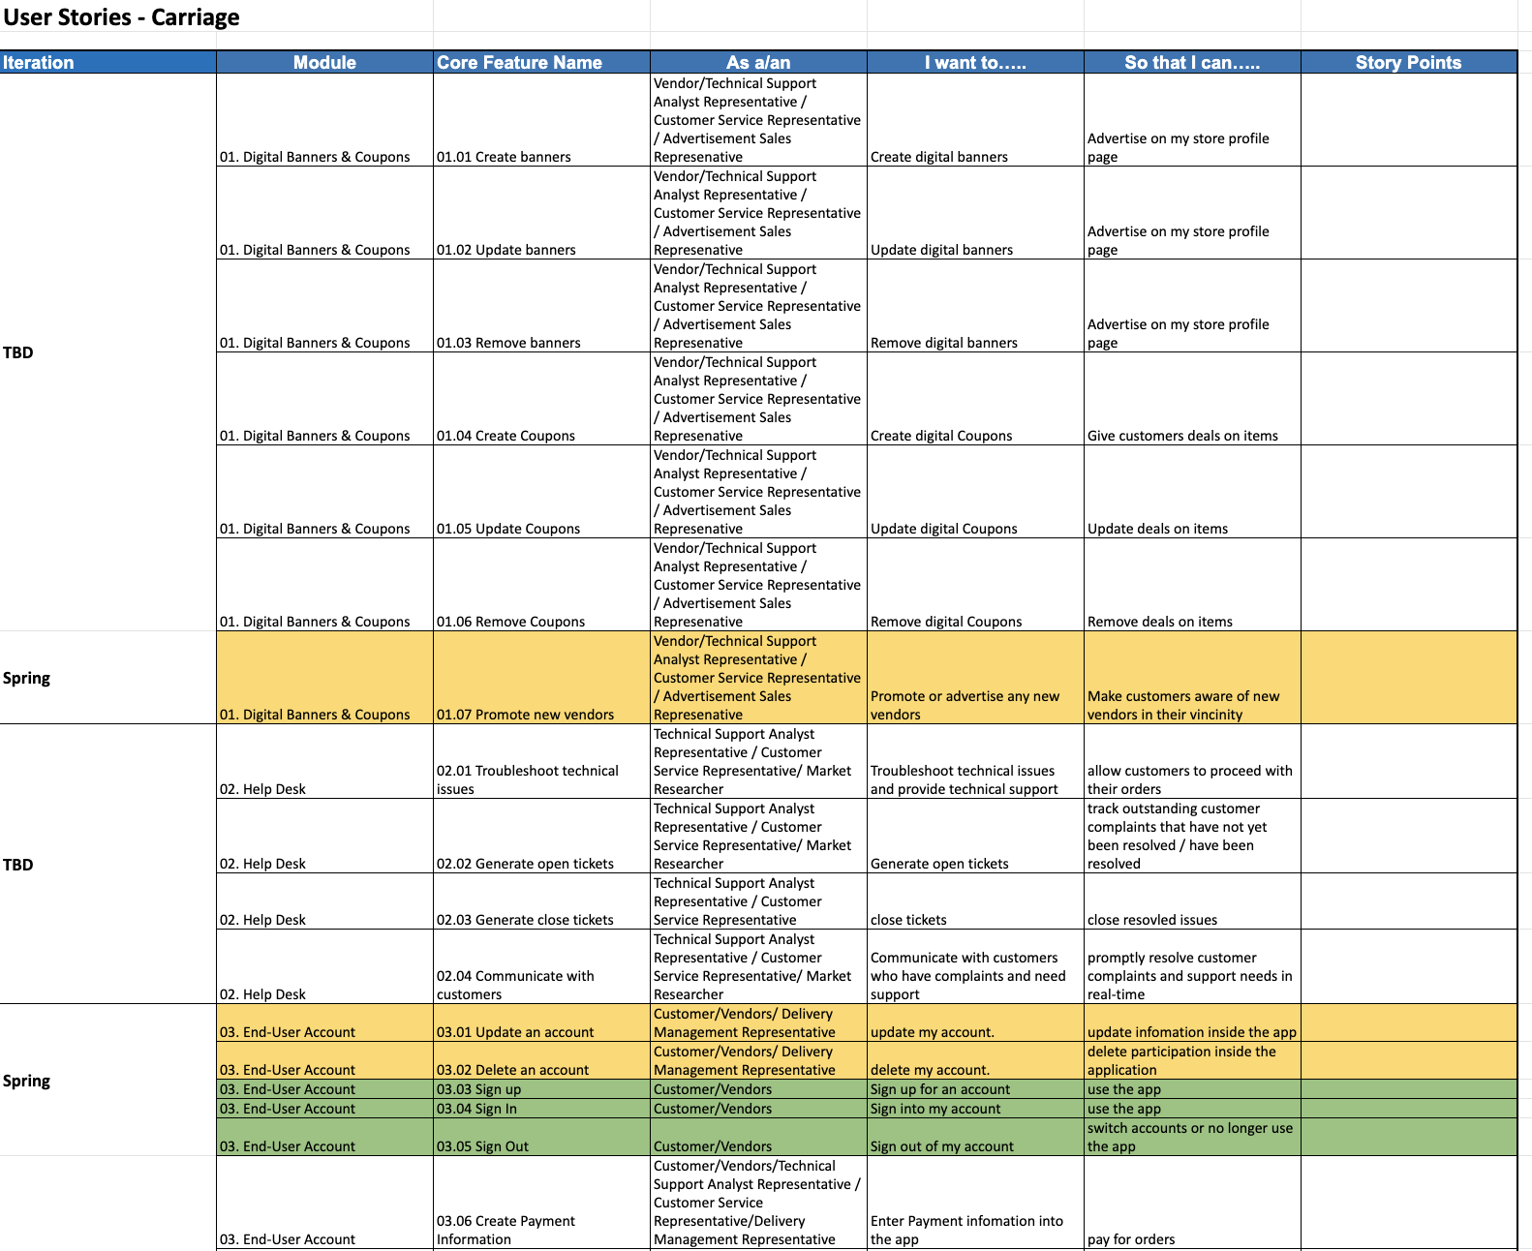
User Stories
Presented by
Mady Dembele

Slide 12

Test Plan
Presented by
Maisha Masnoon & Tianqi Han

Slide 13
GitHub
Presented by
Jevon Cowell

Slide 14
App Demo
Presented by
George Lopez

Slide 15
Thank you!

